Slide 1

Lecture 02
Application Layer
Computer Networking: A Top Down Approach
7th edition
Jim Kurose, Keith Ross
Pearson/Addison Wesley
April 2016
Application Layer
2-<number>

Slide 2
Chapter 2: outline
2.1 principles of network applications
2.2 Web and HTTP
2.3 electronic mail
  SMTP, POP3, IMAP
2.5 P2P applications
Application Layer
2-<number>

Slide 3
Web and HTTP
First, a review…
web page consists of objects
object can be HTML file, JPEG image, Java applet, audio file,…
web page consists of base HTML-file which includes several referenced objects
each object is addressable by a URL, e.g.,
www.someschool.edu/someDept/pic.gif
host name
path name
Application Layer
2-<number>

Slide 4


HTTP overview
HTTP: hypertext transfer protocol
Web’s application layer protocol
client/server model
  client: browser that requests, receives, (using HTTP protocol) and “displays” Web objects
  server: Web server sends (using HTTP protocol) objects in response to requests
HTTP request
PC running
Firefox browser
HTTP response
HTTP request
server
running
Apache Web
server
HTTP response
iPhone running
Safari browser
Application Layer
2-<number>

Slide 5
HTTP overview (continued)
uses TCP:
client initiates TCP connection (creates socket) to server, port 80
server accepts TCP connection from client
HTTP messages (application-layer protocol messages) exchanged between browser (HTTP client) and Web server (HTTP server)
TCP connection closed
HTTP is “stateless”
server maintains no information about past client requests
aside
protocols that maintain “state” are complex!
past history (state) must be maintained
if server/client crashes, their views of “state” may be inconsistent, must be reconciled
Application Layer
2-<number>

Slide 6
HTTP connections
non-persistent HTTP
at most one object sent over TCP connection
  connection then closed
downloading multiple objects required multiple connections
persistent HTTP
multiple objects can be sent over single TCP connection between client, server
Application Layer
2-<number>

Slide 7
Non-persistent HTTP
suppose user enters URL:
(contains text,
references to 10
jpeg images)
www.someSchool.edu/someDepartment/home.index
1a. HTTP client initiates TCP connection to HTTP server (process) at www.someSchool.edu on port 80
1b. HTTP server at host www.someSchool.edu waiting for TCP connection at port 80. “accepts” connection, notifying client
2. HTTP client sends HTTP request message (containing URL) into TCP connection socket. Message indicates that client wants object someDepartment/home.index
3. HTTP server receives request message, forms response message containing requested object, and sends message into its socket
time
Application Layer
2-<number>

Slide 8
Non-persistent HTTP (cont.)
4. HTTP server closes TCP connection.
5. HTTP client receives response message containing html file, displays html. Parsing html file, finds 10 referenced jpeg objects
time
6. Steps 1-5 repeated for each of 10 jpeg objects
Application Layer
2-<number>

Slide 9
Non-persistent HTTP: response time
Round-Trip Time RRT (definition): time for a small packet to travel from client to server and back
HTTP response time:
one RTT to initiate TCP connection
one RTT for HTTP request and first few bytes of HTTP response to return
file transmission time
non-persistent HTTP response time =
  2RTT+ file transmission time
initiate TCP
connection
RTT
request
file
RTT
time to
transmit
file
file
received
time
time
Application Layer
2-<number>

Slide 10
Persistent HTTP
non-persistent HTTP issues:
requires 2 RTTs per object
OS overhead for each TCP connection
browsers often open parallel TCP connections to fetch referenced objects
persistent HTTP:
server leaves connection open after sending response
subsequent HTTP messages between same client/server sent over open connection
client sends requests as soon as it encounters a referenced object
as little as one RTT for all the referenced objects
Application Layer
2-<number>

Slide 11
HTTP request message
two types of HTTP messages: request, response
HTTP request message:
  ASCII (human-readable format)
carriage return character
request line
(GET, POST,
HEAD commands)
line-feed character
GET /index.html HTTP/1.1\r\n
Host: www-net.cs.umass.edu\r\n
User-Agent: Firefox/3.6.10\r\n
Accept: text/html,application/xhtml+xml\r\n
Accept-Language: en-us,en;q=0.5\r\n
Accept-Encoding: gzip,deflate\r\n
Accept-Charset: ISO-8859-1,utf-8;q=0.7\r\n
Keep-Alive: 115\r\n
Connection: keep-alive\r\n
\r\n
header
lines
carriage return,
line feed at start
of line indicates
end of header lines
* Check out the online interactive exercises for more examples: http://gaia.cs.umass.edu/kurose_ross/interactive/
Application Layer
2-<number>

Slide 12
HTTP request message: general format
method
sp
URL
sp
version
cr
request
line
lf
header field name
value
cr
lf
~
~
header
lines
~
~
header field name
value
cr
lf
cr
lf
~
entity body
~
body
~
~
Application Layer
2-<number>

Slide 13
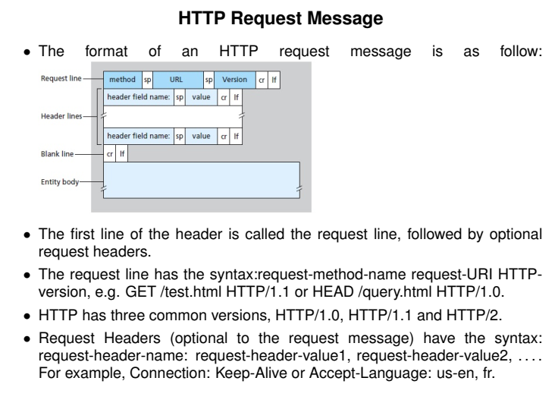
HTTP request message: general format

Slide 14
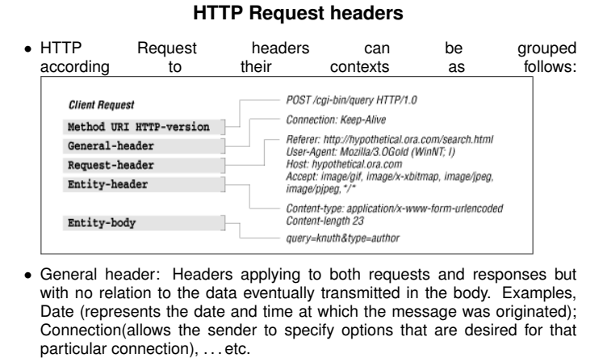
HTTP request message: general format

Slide 15
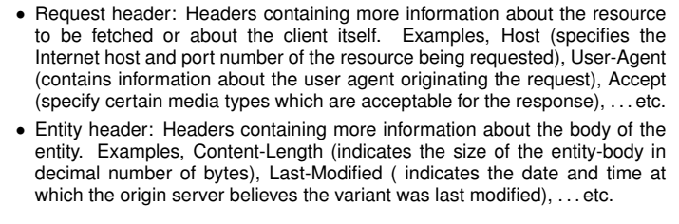
HTTP request message: general format

Slide 16
Uploading form input
POST method:
web page often includes form input
input is uploaded to server in entity body
URL method:
uses GET method
input is uploaded in URL field of request line:
www.somesite.com/animalsearch?monkeys&banana
Application Layer
2-<number>

Slide 17
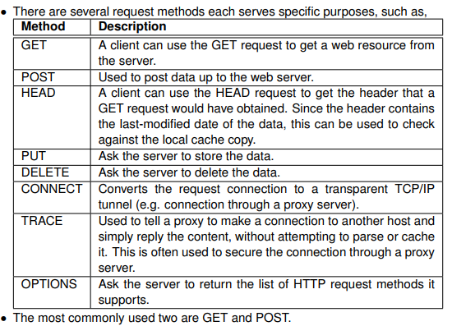
Method types
Application Layer
2-<number>

Slide 18
HTTP response message
status line
(protocol
status code
status phrase)
HTTP/1.1 200 OK\r\n
Date: Sun, 26 Sep 2010 20:09:20 GMT\r\n
Server: Apache/2.0.52 (CentOS)\r\n
Last-Modified: Tue, 30 Oct 2007 17:00:02 GMT\r\n
ETag: "17dc6-a5c-bf716880"\r\n
Accept-Ranges: bytes\r\n
Content-Length: 2652\r\n
Keep-Alive: timeout=10, max=100\r\n
Connection: Keep-Alive\r\n
Content-Type: text/html; charset=ISO-8859-1\r\n
\r\n
data data data data data ...
header
lines
data, e.g.,
requested
HTML file
* Check out the online interactive exercises for more examples: http://gaia.cs.umass.edu/kurose_ross/interactive/
Application Layer
2-<number>

Slide 19
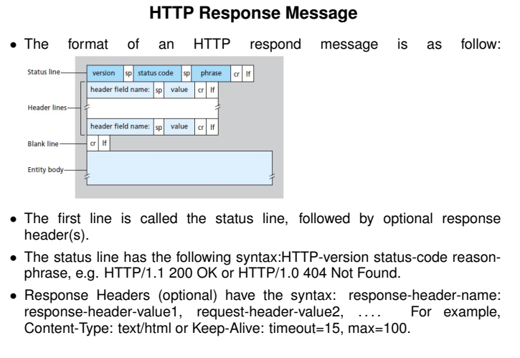
HTTP response message

Slide 20
HTTP response status codes
status code appears in 1st line in server-to-client response message.
some sample codes:
200 OK
  request succeeded, requested object later in this msg
301 Moved Permanently
  requested object moved, new location specified later in this msg (Location:)
400 Bad Request
  request msg not understood by server
404 Not Found
  requested document not found on this server
505 HTTP Version Not Supported
Application Layer
2-<number>

